Slide 1


Spatial Transcriptome with R programming
2023 The 19th KOGO Winter Workshop
2023. 2. 1. Wed
Choi Lab
Korea University College of Medicine

Slide 2
Table of Contents
What is R programming?
Space Ranger
Clustering Analysis – Bayesspace
Cell-cell interaction – CellChat
Summary
Q&A
Github repository for the workshop : https://github.com/parkjooyoung99/KOGO_2023

Slide 3
What is R programming?
1

Slide 4



What is R and Why R?
R is used widely in biological research and provides a solid platform for beginner scientific programmers.
Many graphing and statistical operations are built right into the language.
It’s free and open-source.
It runs on all major operating systems.
R is the most common statistics platform in genomics and easy to use.
Bioconductor uses the R statistical programming language and is open source and open development.
Modified from : https://datacarpentry.org/semester-biology/about/why-r/
https://www.bioconductor.org/

Slide 5
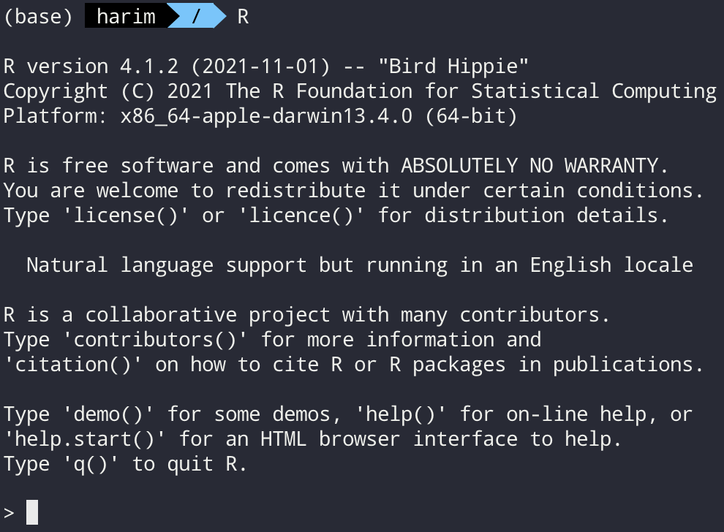
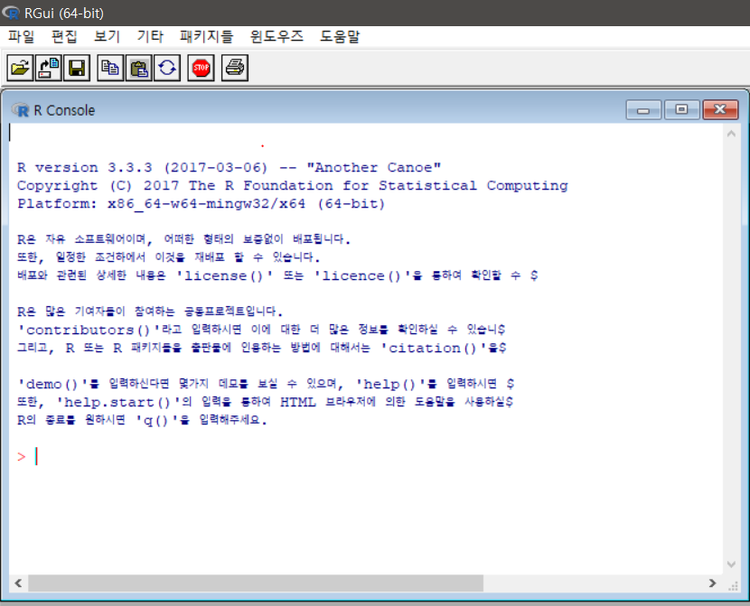
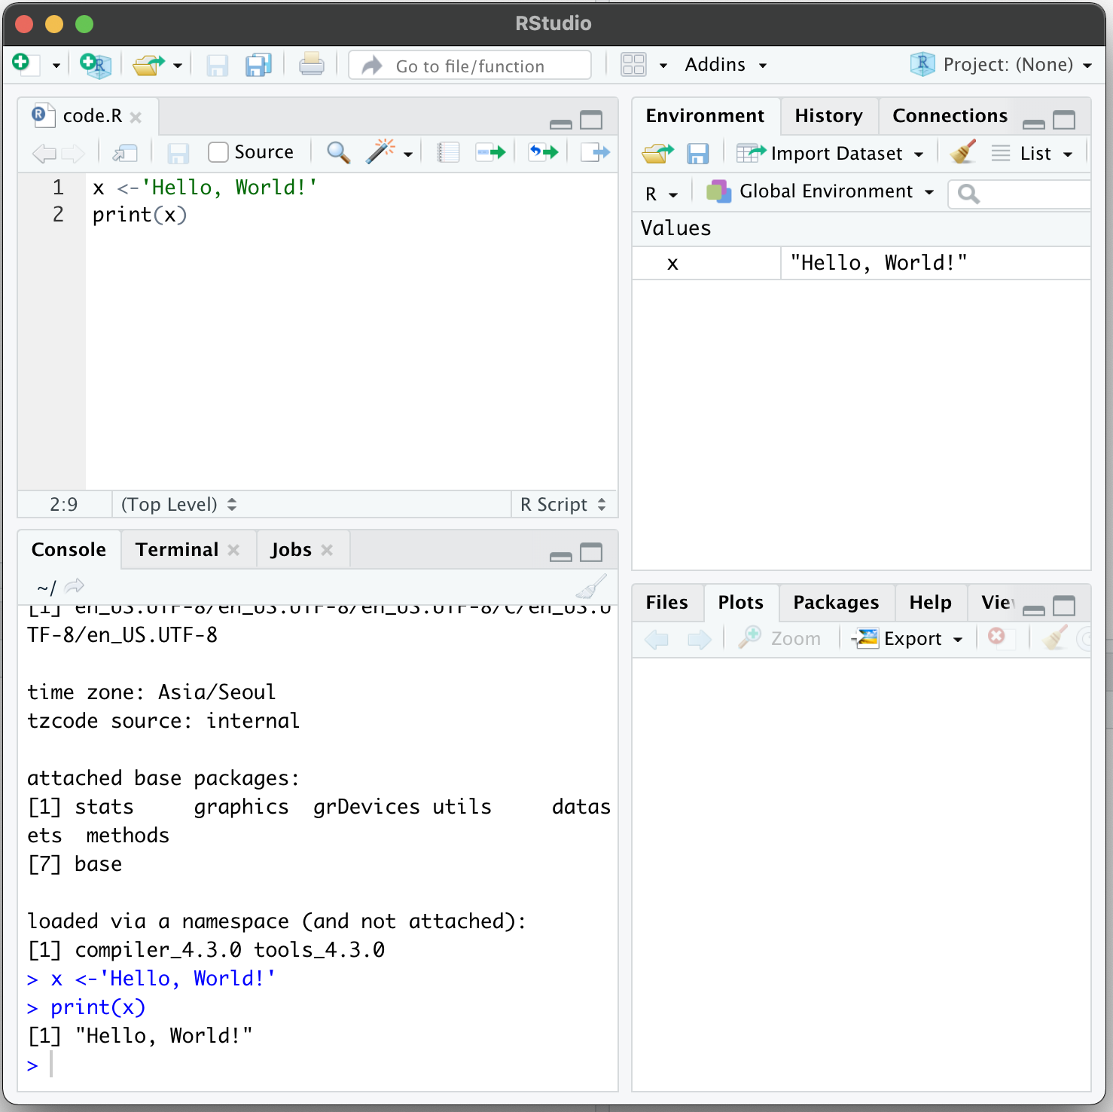
Several ways to use R
Command line
Graphical user interface
Rstudio

Slide 6
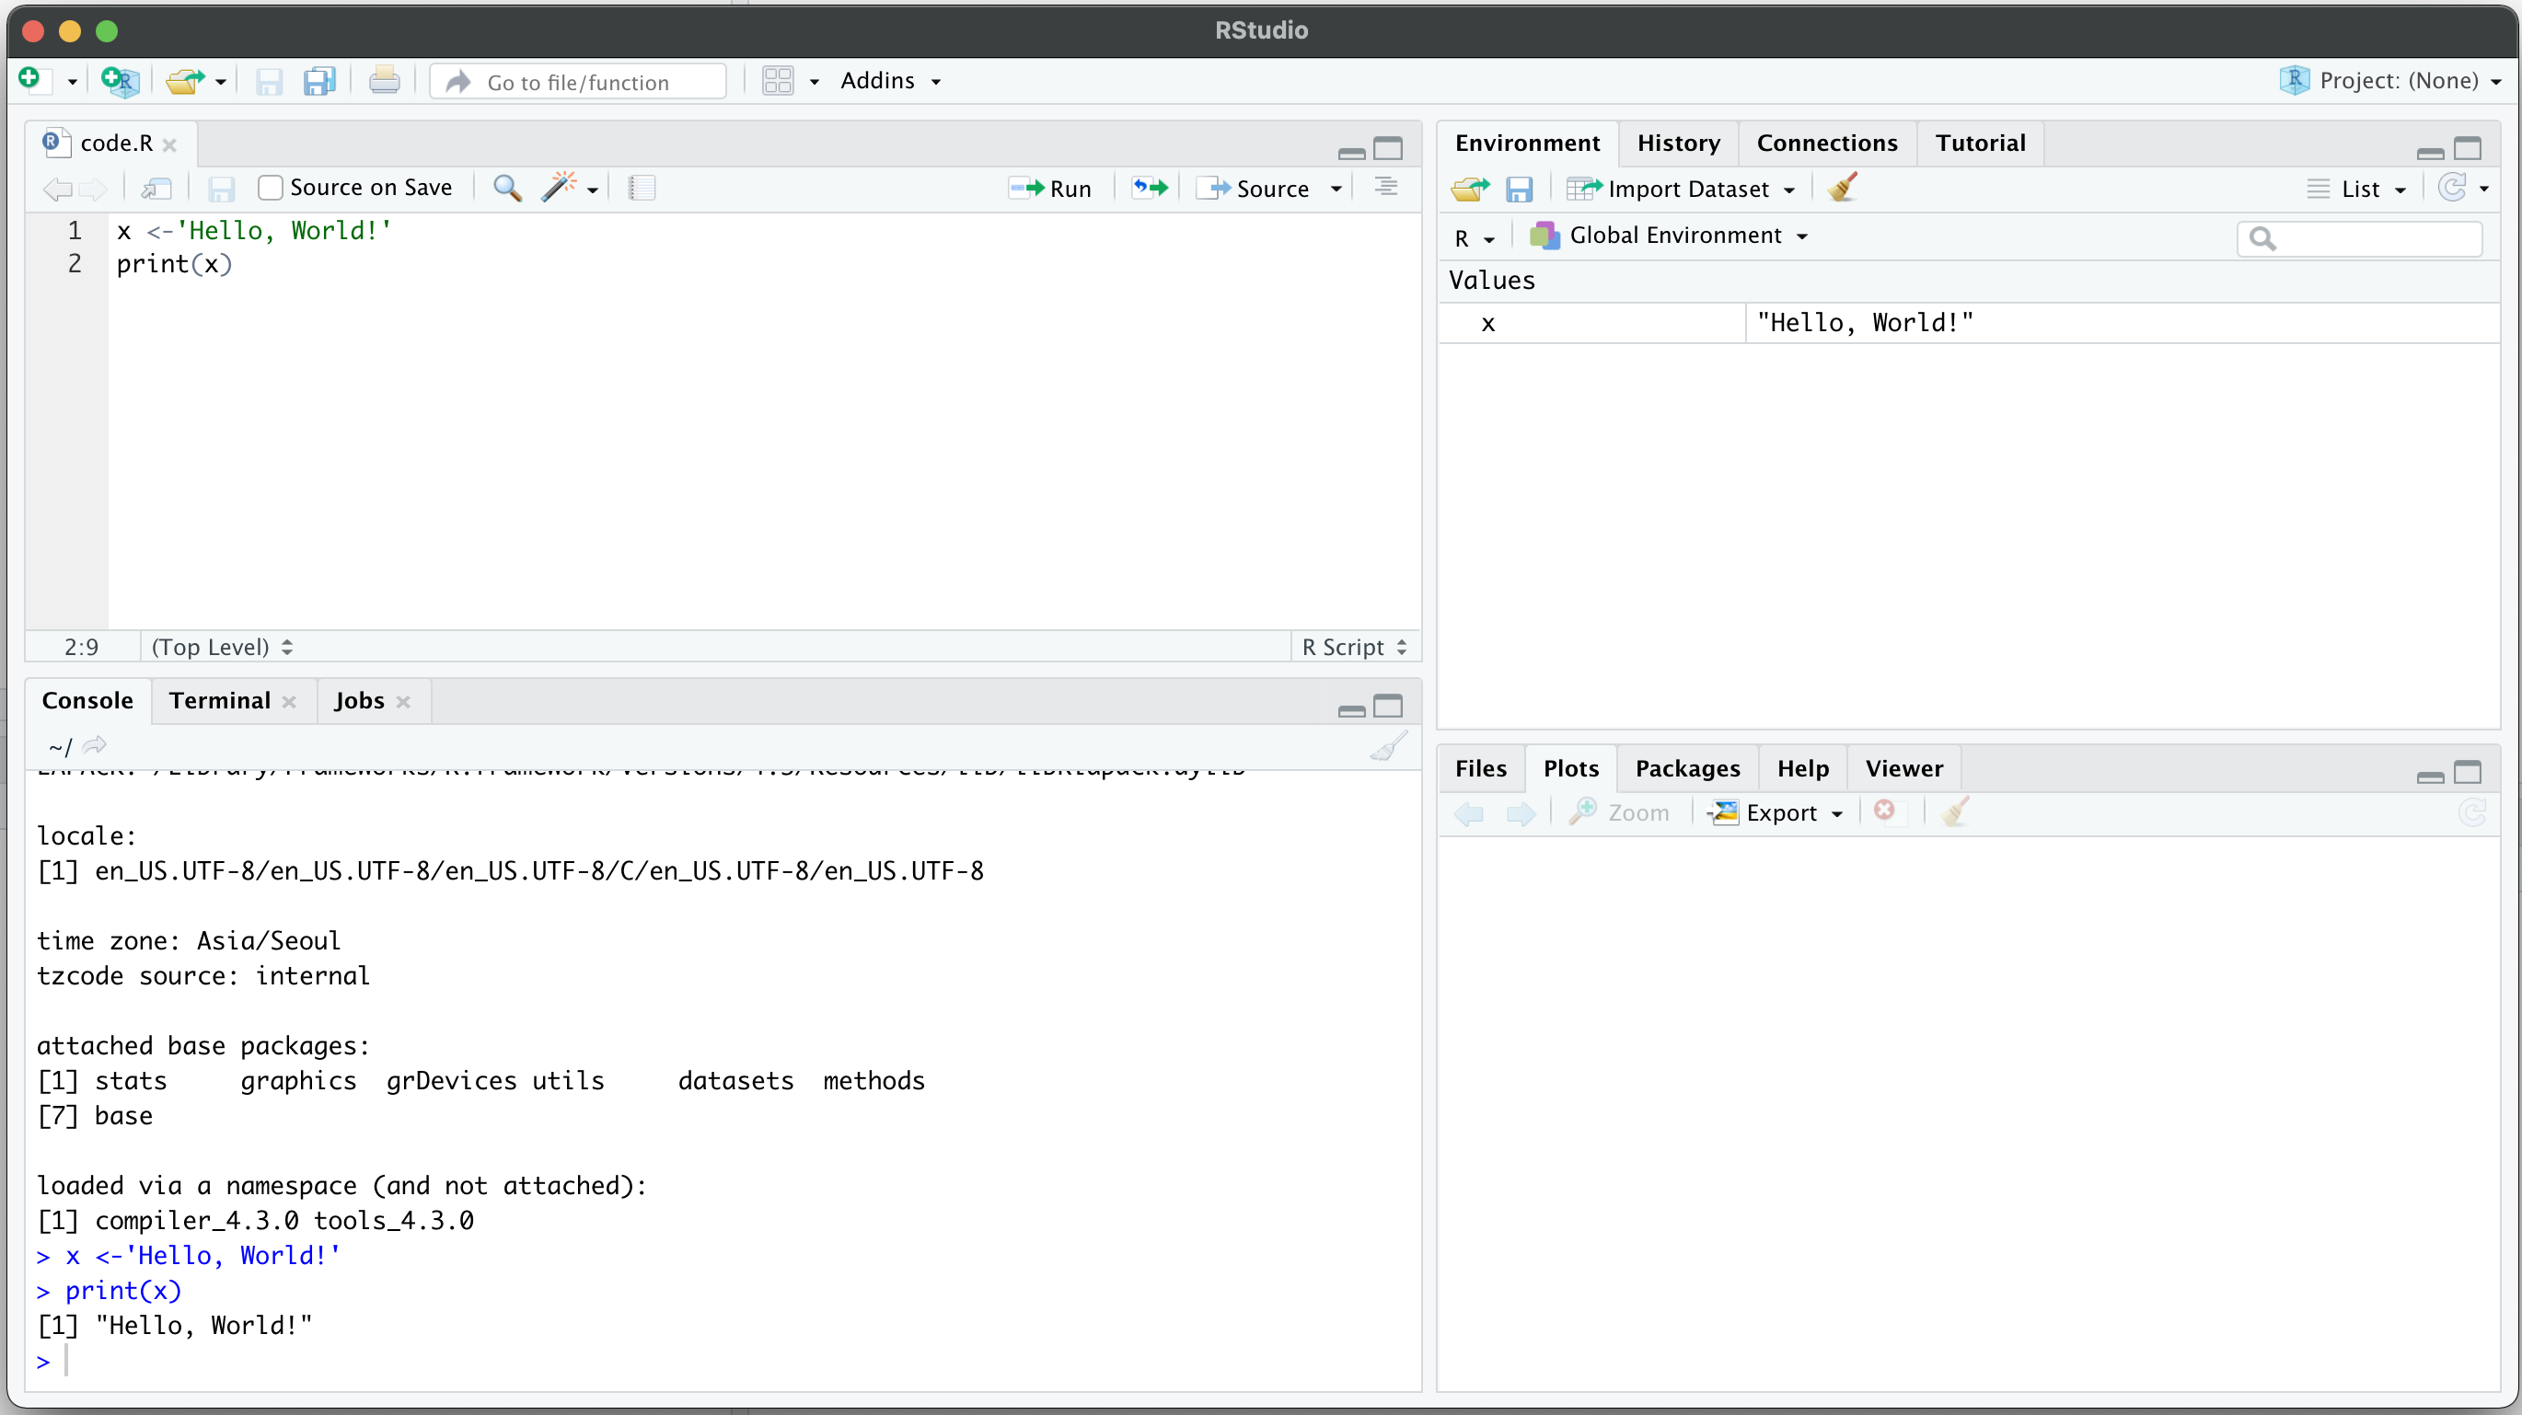
Rstudio
Rstudio – Integrated development environment (IDE) for R and python
Code editor
Environment / History
R console
Other panes
(Files, Plots, Packages, Help)

Slide 7
Space Ranger
2

Slide 8
What is Space Ranger?
Space Ranger is a set of analysis pipelines for processing 10X Genomics Visium sequence data (FASTQ files) with high resolution microscope images of tissue.
It maps the transcriptomic reads to the microscope image of the tissue from which the reads were obtained
We will introduce spaceranger count pipeline among the 5 pipelines

Slide 9
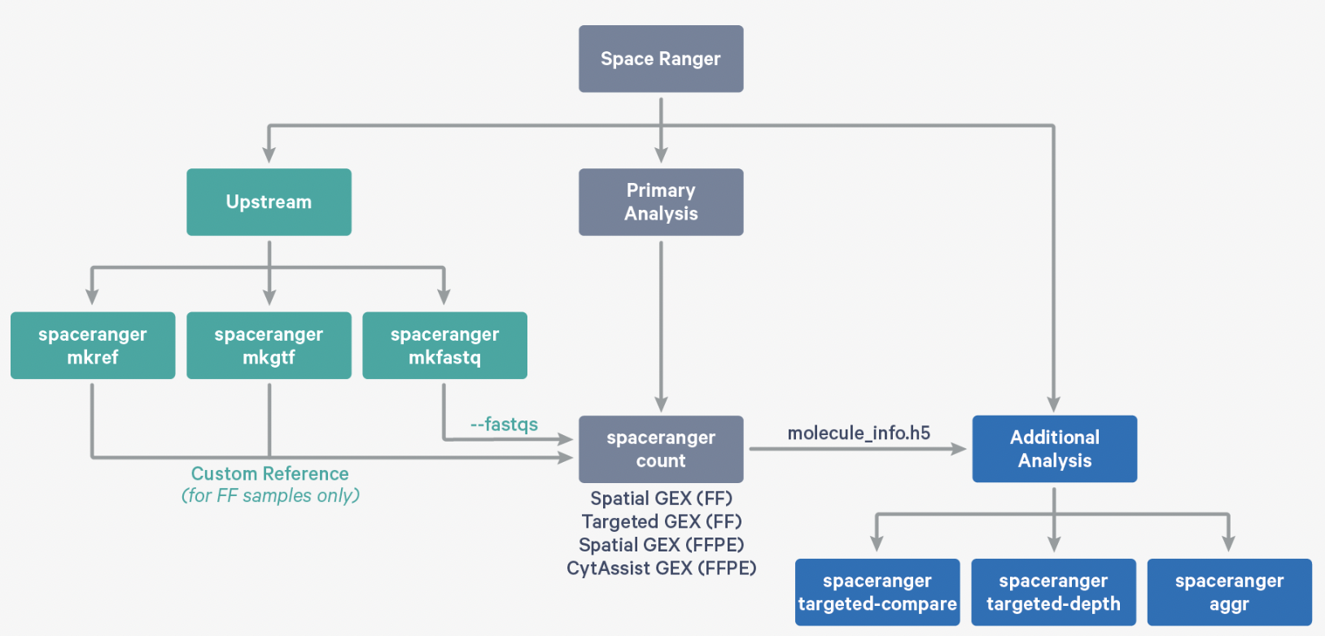
Space Ranger Pipelines
spaceranger mkfastq
spaceranger count
spaceranger aggr
spaceranger targeted-compare
spaceranger targeted-depth
https://support.10xgenomics.com/spatial-gene-expression/software/pipelines/latest/what-is-space-ranger

Slide 10
Installing Space Ranger
Download and unpack the Space Ranger .tar.gz file in any location
Download and unpack proper reference data .tar.gz file in a convenient location
3. Pre-pend the Space Ranger directory to your $PATH
$cd /opt
$tar -xzvf spaceranger-2.0.0.tar.gz
$tar -xzvf refdata-gex-GRCh38-2020-A.tar.gz
$export PATH=/opt/spaceranger-2.0.0:$PATH
https://support.10xgenomics.com/spatial-gene-expression/software/pipelines/latest/installation

Slide 11
Run spaceranger count command
$cd /home/jdoe/runs
$spaceranger count --id=sample345 \ #Output directory
--transcriptome=/home/jdoe/refdata/GRCh38-2020-A \ #Path to Reference
--fastqs=/home/jdoe/runs/HAWT7ADXX/outs/fastq_path \ #Path to FASTQs
--sample=mysample \ #Sample name from FASTQ filename
--image=/home/jdoe/runs/images/sample345.tiff \ #Path to brightfield image
--slide=V19J01-123 \ #Slide ID
--area=A1 \ #Capture area
--localcores=8 \ #Allowed cores in localmode
--localmem=64 #Allowed memory (GB) in localmode
https://support.10xgenomics.com/spatial-gene-expression/software/pipelines/latest/using/count
Input : the microscope image (.tiff), FASTQ files(Fastq)
Perform : sequence alignment, tissue detection
Output : gene-spot matrix

Slide 12
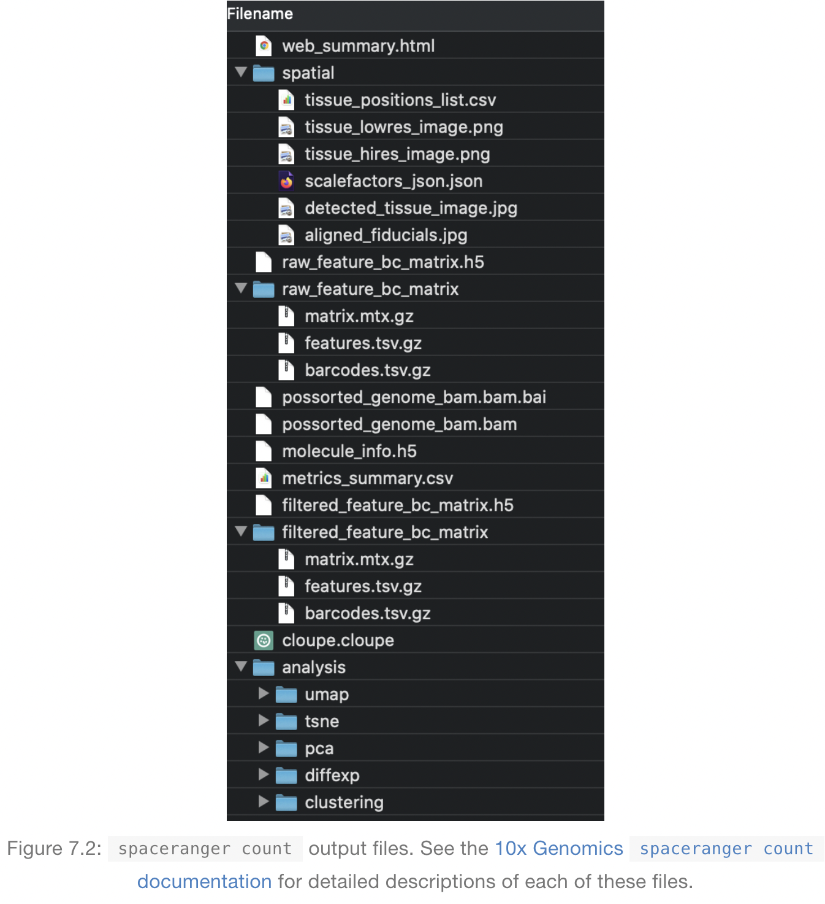
Output files of Space Ranger
read10XVisium Input files
https://lmweber.org/OSTA-book/space-ranger-visium.html

Slide 13
Output files
raw_feature_bc_matrix
Dataset having spots that theoretically don’t overlap with tissue
filtered_feature_bc_matrix
Dataset filtered to the spots overlapping tissue, as determined by Loupe Browser
(Visium) alignment file
tissue_positions_list.csv
The spot coordinates information is stored
scalefactors_json.json
Scaling factors that convert spot coordinates to pixel coordinates
metrics_summary.csv
Metrics displayed in the interactive website
web_summary.html
Interactive website

Slide 14
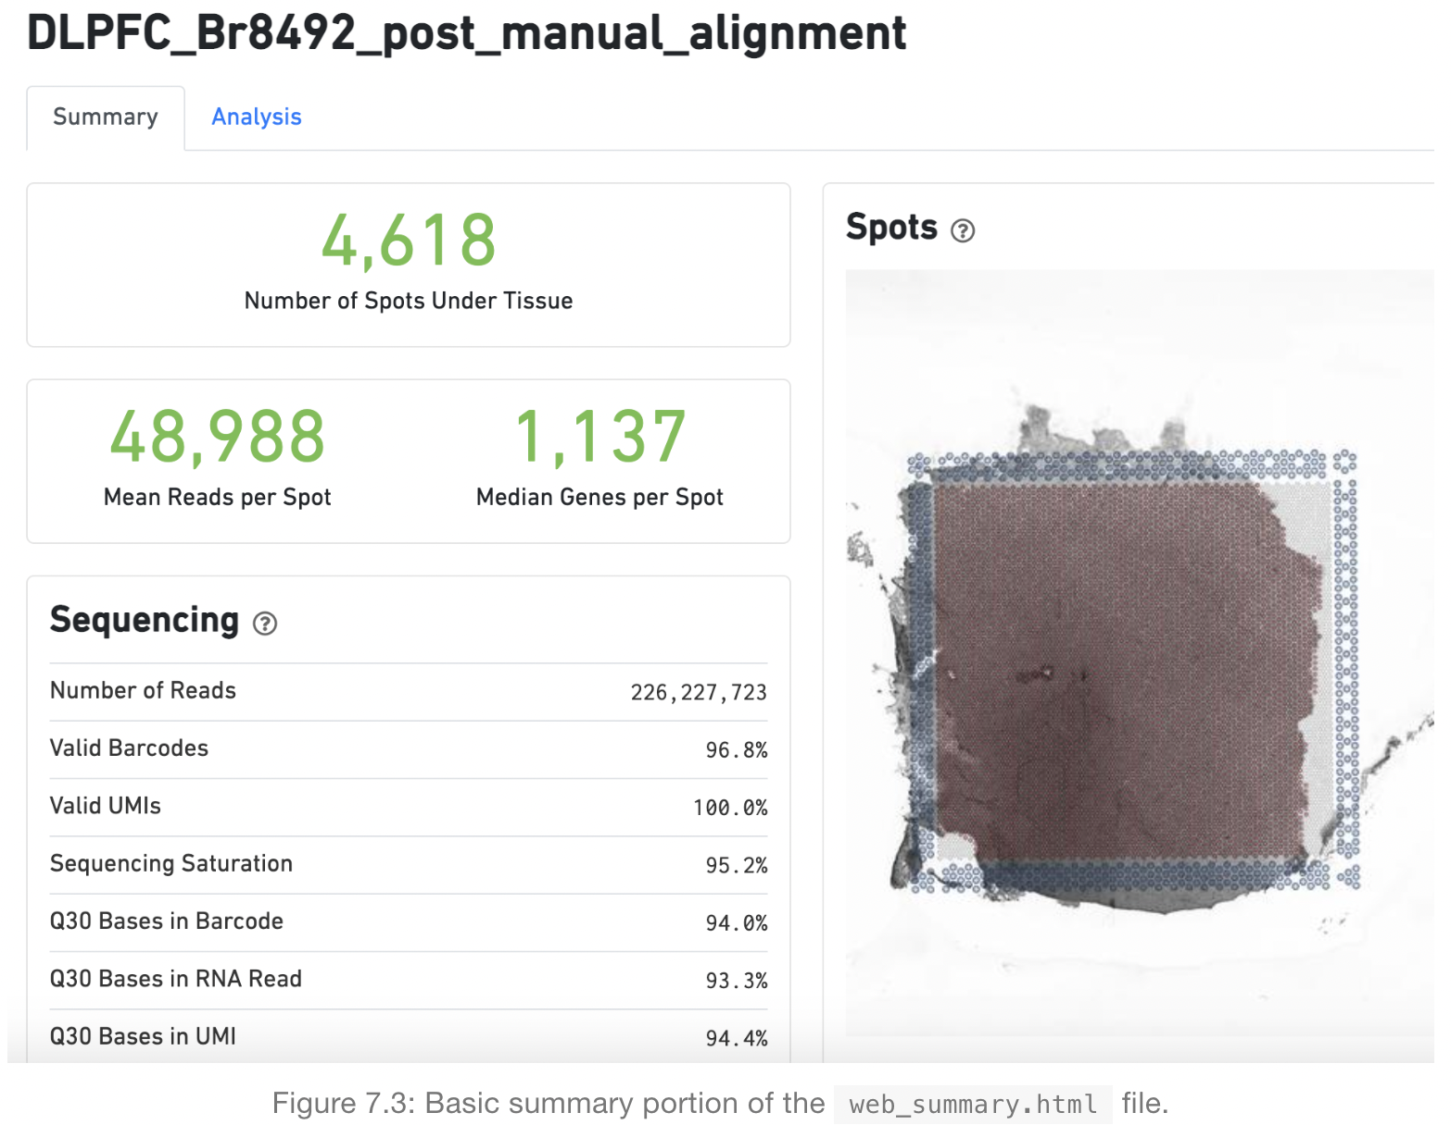
Web summary .html file
Sequencing Saturation
The fraction of reads originating from an
already-observed UMI. Function of library
complexity and sequencing depth
Q30 Bases
Fraction of bases with Q-score >= 30,
excluding very low quality/no-call (Q <= 2)
bases from the denominator
https://lmweber.org/OSTA-book/space-ranger-visium.html

Slide 15
What is a Loupe Browser?
Loupe Browser is a desktop application from 10x Genomics that allows to visualize gene expression data without having to write code
Manual alignment of images
Align gene expression spots to histological images, look for marker gene expression, annotate populations, and cluster
The .cloupe file is the one that need to import into the Loupe Browser in order to explore the processed data. These files are generally between 1 and 2 GB each.

Slide 16
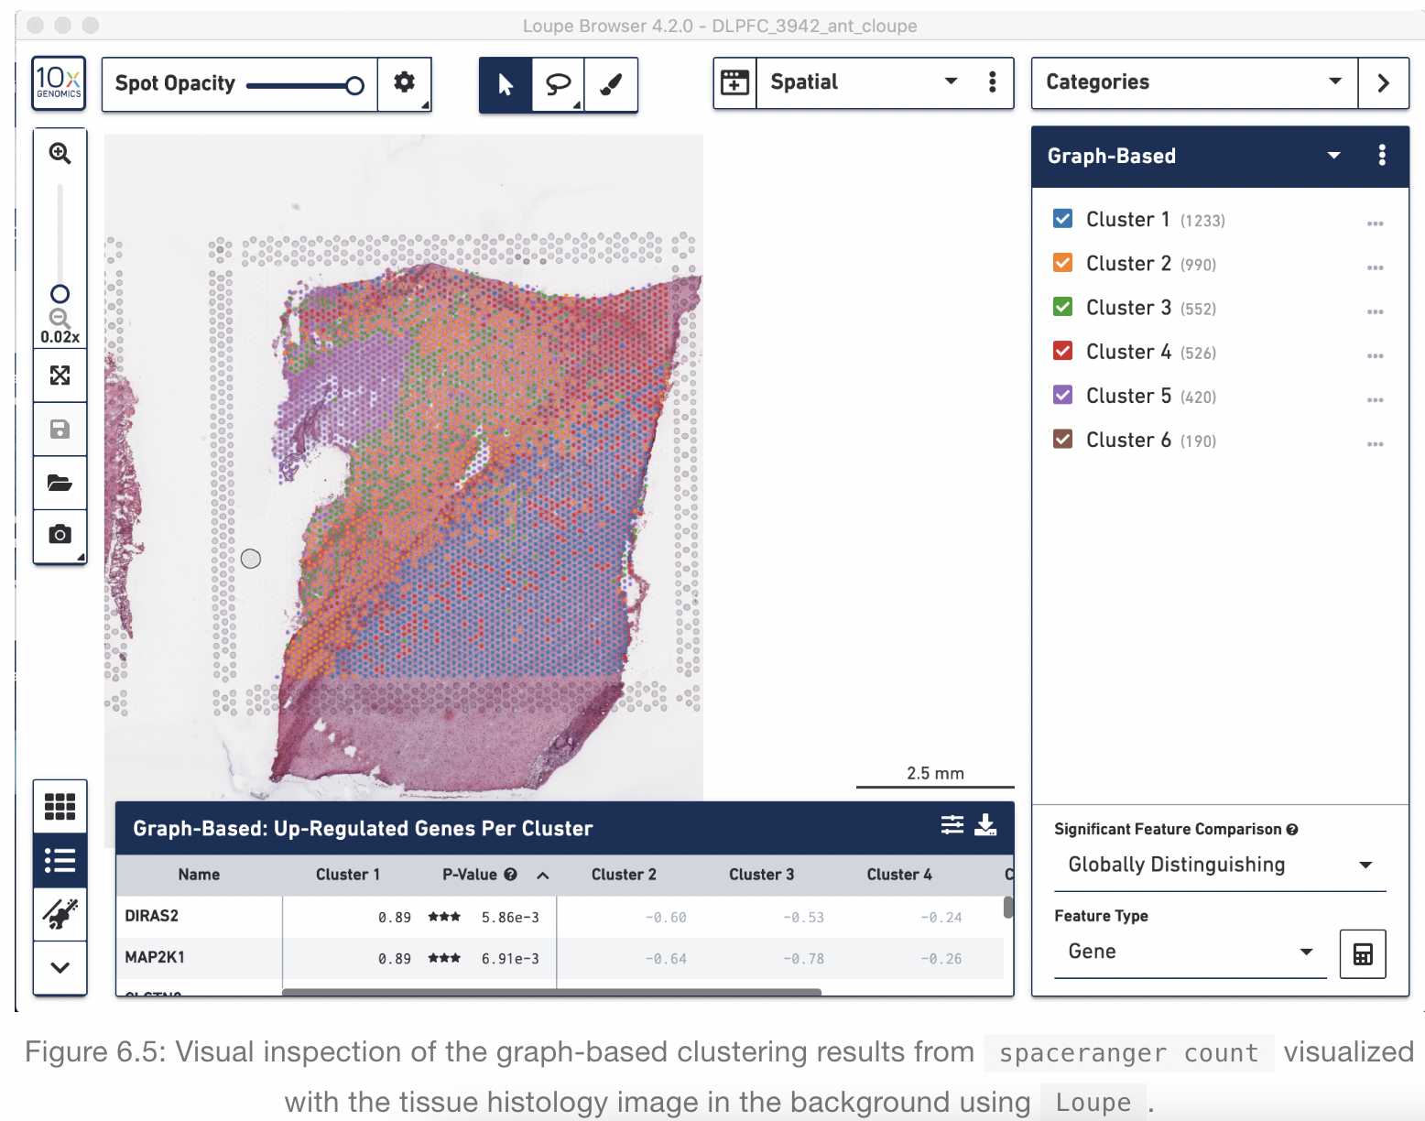
Loupe Browser
Histology image &
UMAP & t-SNE
Manual Annotation of spots
https://support.10xgenomics.com/spatial-gene-expression/software/visualization/latest/analysis

Slide 17
Load a 10X Visium dataset in R as a SinglecellExperiment
Creating sce object with one line code
sce = readVisium("path/to/spaceranger/outs/")

Slide 18
Load a 10X Visium dataset in R as a SinglecellExperiment
Creating sce object manually
spatial_dir = file.path(“path/to/spaceranger/outs”, "spatial")
matrix_dir = file.path(“path/to/spaceranger/outs”, "filtered_feature_bc_matrix")
colData = read.csv(file.path(spatial_dir, "tissue_positions.csv"), header=FALSE)
colnames(colData) = c("spot", "in_tissue", "row", "col", "imagerow", "imagecol")
rownames(colData) = colData$spot
colData = colData[colData$in_tissue > 0, ]
colData = colData[-1,]
head(colData)
colData = as.data.frame(sapply(colData , as.numeric), row.names = rownames(colData))
colData$spot = rownames(colData)
rowData = read.table(file.path(matrix_dir, "features.tsv.gz"), header=FALSE, sep = "\t")
colnames(rowData) = c("gene_id", "gene_name", "feature_type")
rowData = rowData[, c("gene_id", "gene_name")]
rownames(rowData) = scater::uniquifyFeatureNames(rowData$gene_id, rowData$gene_name)
counts = Matrix::readMM(file.path(matrix_dir, "matrix.mtx.gz"))
barcodes = read.table(file.path(matrix_dir, "barcodes.tsv.gz"), header=FALSE, sep = "\t")
colnames(counts) = barcodes$V1
rownames(counts) = rownames(rowData)
counts = counts[, rownames(colData)]
sce = SingleCellExperiment(assays=list(counts=counts),
rowData=rowData,
colData=colData)
metadata(sce)$BayesSpace.data = list()
metadata(sce)$BayesSpace.data$platform = "Visium"
metadata(sce)$BayesSpace.data$is.enhanced = FALSE
sce$sample_name = ‘your_sample_name’

Slide 19
Clustering Analysis - BayesSpace
3

Slide 20
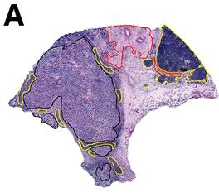
Dataset Description
For convenience, we will use ST Visium dataset generated from one of the melanoma samples originally reported by Thrane et al. (2018)
Figure 3A.
melanoma (black), stromal (red), and lymphoid (yellow) tissue regions.

Slide 21
Download packages in current R environment
bio_pkgs = c(“BayesSpace”,”SingleCellExperiment”,”scran”,”scater”)
BiocManager::install(bio_pkgs, update = T, force =TRUE)
install.packages(“Seurat”)
install.packages(“ggplot2”)
install.packages(“dplyr”)
install.packages(“patchwork”)

Slide 22
Load packages in current R environment
Load data
Preprocessing
Feature selection / Dimension reduction
Clustering
Annotation
invisible(lapply(c(bio_pkgs,'dplyr','Seurat','ggplot2','patchwork'), function(x) library(x, character.only=TRUE)))
set.seed(1234)

Slide 23
Load dataset
Load data
Preprocessing
Feature selection / Dimension reduction
Clustering
Annotation
Load prebuilt dataset
melanoma = getRDS(dataset="2018_thrane_melanoma", sample="ST_mel1_rep2")
same with
melanoma <- getRDS(dataset="2018_thrane_melanoma", sample="ST_mel1_rep2")

Slide 24
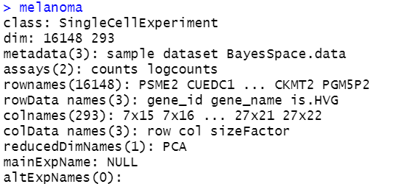
Explore our data – Overall data
Load data
Preprocessing
Feature selection / Dimension reduction
Clustering
Annotation
Explore overall data
melanoma
With your raw data, gray boxed parts will not appear. These will be added after preprocessing.

Slide 25
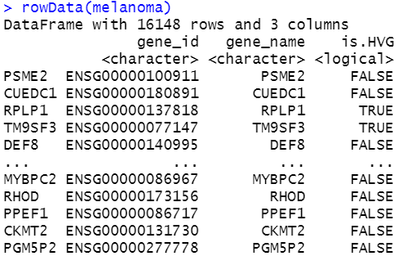
Explore our data – Row data
Load data
Preprocessing
Feature selection / Dimension reduction
Clustering
Annotation
Explore Row data
melanoma
rowData(melanoma)
With your raw data, gray boxed part will not appear. This will be added after preprocessing.

Slide 26
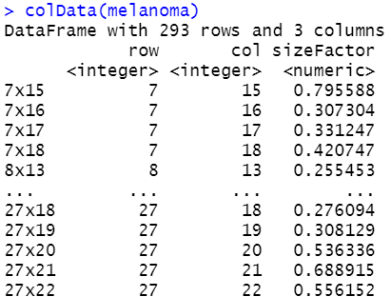
Explore our data – Col data
Load data
Preprocessing
Feature selection / Dimension reduction
Clustering
Annotation
Explore Col data
melanoma
colData(melanoma)
For 10X Visium data, colData will have 6 columns
: spot, in_tissue, row, col, imagerow,
imagecol

Slide 27
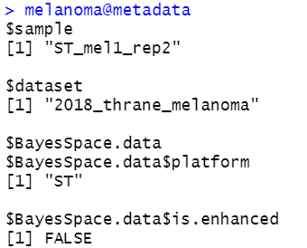
Preprocessing
Load data
Preprocessing
Feature selection / Dimension reduction
Clustering
Annotation
Add metadata
metadata(melanoma)$BayesSpace.data = list()
metadata(melanoma)$BayesSpace.data$platform = "ST”
metadata(melanoma)$BayesSpace.data$is.enhanced = FALSE

Slide 28
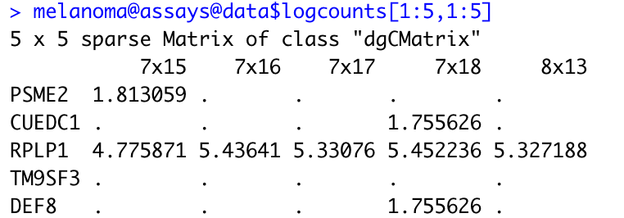
Preprocessing
Load data
Preprocessing
Feature selection / Dimension reduction
Clustering
Annotation
Log normalize
melanoma = logNormCounts(melanoma)
melanoma@assays@data$logcounts[1:10,1:10]
Normalized count = log((counts/librarysizefactor) + 1)
Librarysizefactor = total sum of counts per cell)

Slide 29
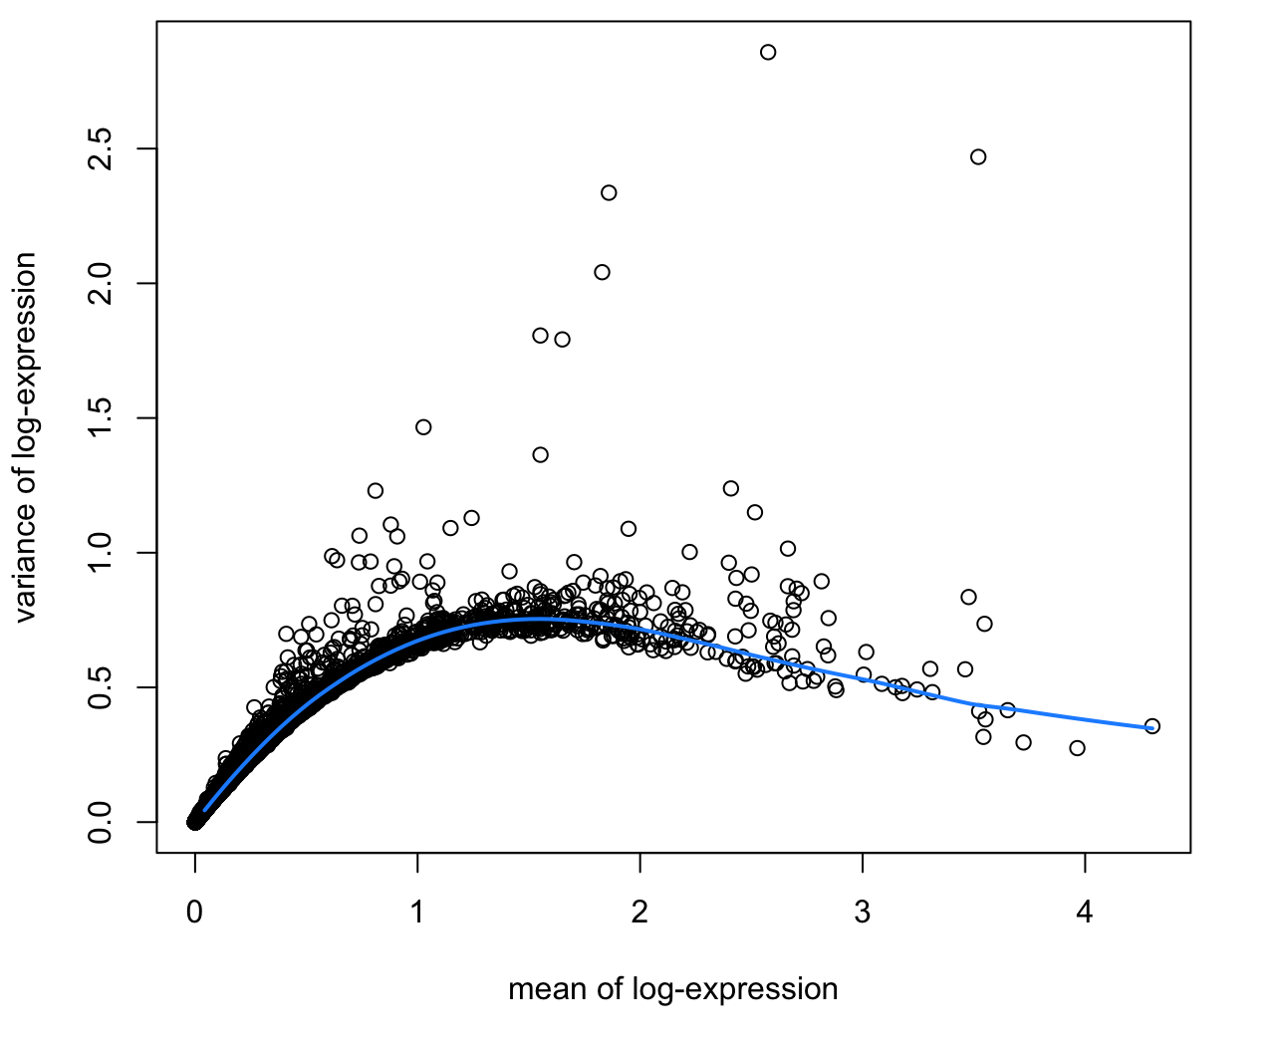
Feature selection and Dimension reduction
Load data
Preprocessing
Feature selection / Dimension reduction
Clustering
Annotation
Feature selection
dec = scran::modelGeneVar(melanoma, assay.type=“logcounts”)
top = scran::getTopHVGs(melanoma, n=2000)
1. Model the trend for variance against the mean with all genes 2. Rank genes with residual from the trend
3. Select Top N genes as HVG

Slide 30
Feature selection and Dimension reduction
Load data
Preprocessing
Feature selection / Dimension reduction
Clustering
Annotation
Dimension reduction - PCA
melanoma = scater::runPCA(melanoma, subset_row = top,ncomponents = 50)
Max
Gene C
Gene B
Min
Gene A
Max
Gene B
Gene A
Min
Gene A
Max

Slide 31
Preprocessing, Feature selection, Dimension reduction at once
Load data
Preprocessing
Feature selection / Dimension reduction
Clustering
Annotation
melanoma = spatialPreprocess(melanoma, platform="ST", n.PCs=50, n.HVGs=2000, log.normalize=TRUE)

Slide 32
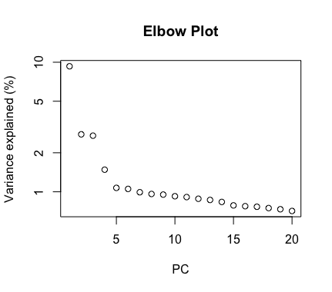
Clustering
Load data
Preprocessing
Feature selection / Dimension reduction
Clustering
Annotation
Select number of PCs to use
percent.var = attr(reducedDim(melanoma), "percentVar")
plot(percent.var[1:20], log="y", xlab="PC", ylab="Variance explained (%)", main = 'Elbow Plot’)
d = 7
Select N around the elbow

Slide 33
BayesSpace algorithm
Load data
Preprocessing
Feature selection / Dimension reduction
Clustering
Annotation
Initial labeling for spots using a non-spatial clustering method such as model (pdf) based clustering method.
Considering neighboring spots’ labels, relabel spots using ‘Metropolis–Hastings algorithm’
Basic Idea of Metropolis–Hastings algorithm
Set initial label(a) and calculate P(pdf(a))
Considering neighboring spots’ label, calculate P(b or c or d) where b,c and d are other labels
If P(b or c or d) is higher than current probability, update the label
Repeat step 2~4
https://www.publichealth.columbia.edu/research/population-health-methods/markov-chain-monte-carlo

Slide 34
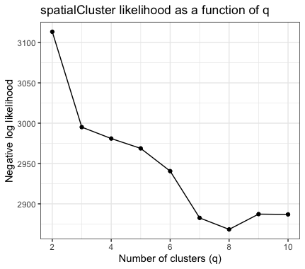
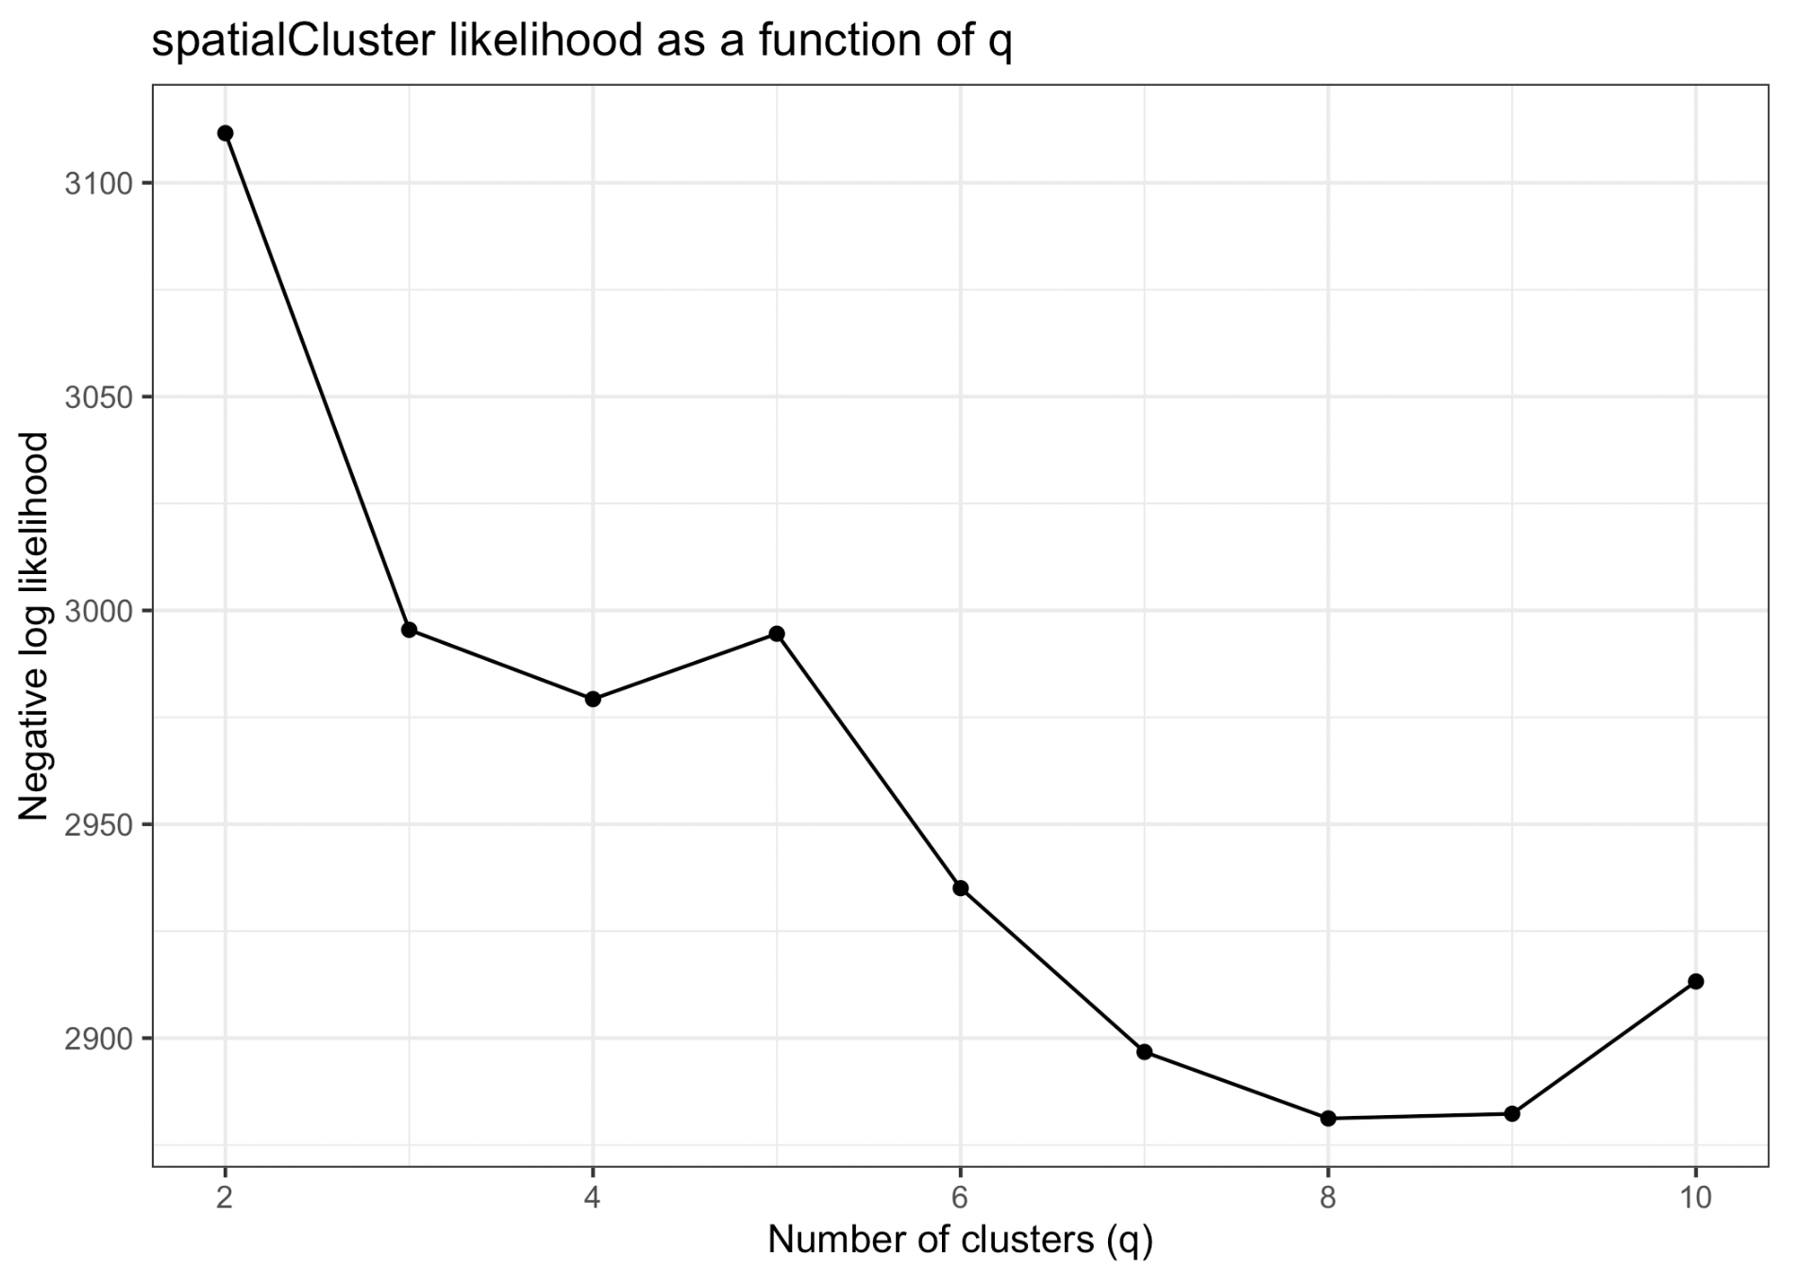
Clustering
Load data
Preprocessing
Feature selection / Dimension reduction
Clustering
Annotation
Select number of clusters to generate
melanoma = qTune(melanoma, qs=seq(2, 10), platform="ST",d=d)
qPlot(melanoma)
q = 4
Select N around the elbow
Tutorial’s plot

Slide 35
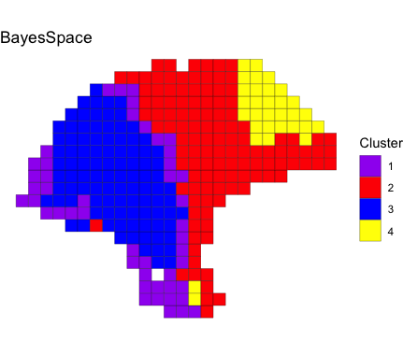
Clustering
Load data
Preprocessing
Feature selection / Dimension reduction
Clustering
Annotation
Clustering with BayesSpace
melanoma = spatialCluster(melanoma, q=q, d=d, gamma=2,
platform="ST", nrep=10000,
save.chain=TRUE)
palette = c("purple", "red", "blue", "yellow", "darkblue")
clusterPlot(melanoma, palette=palette, color="black", size=0.1) +labs(title="BayesSpace")
saveRDS(melanoma,'melanoma.rds')

Slide 36
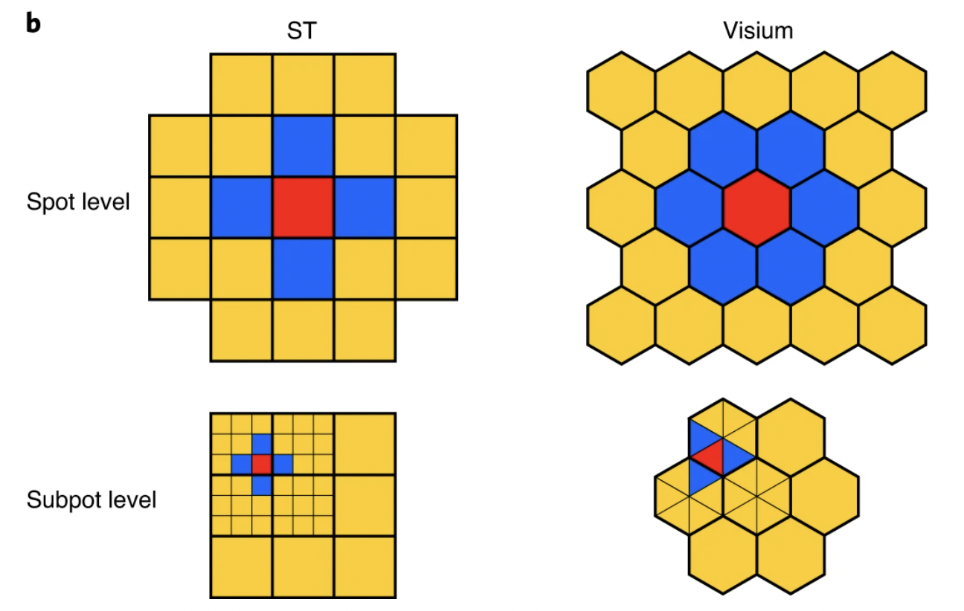
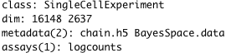
Clustering
Load data
Preprocessing
Feature selection / Dimension reduction
Clustering
Annotation
Enhancing resolution (1/2)
melanoma.enhanced = spatialEnhance(melanoma, q=q, d=d, platform="ST", gamma=2, nrep=200000, verbose=TRUE, save.chain=TRUE, jitter_scale=3.5, jitter_prior=0.3)
melannoma.enhanced = readRDS(url(“https://parkjooyoung99.github.io/KOGO_2023/data/
KOGO_2023_spatial_transcriptomics_melanoma_enhanced_object.rds”))
melanoma.enhanced
melanoma.enhanced
melanoma

Slide 37
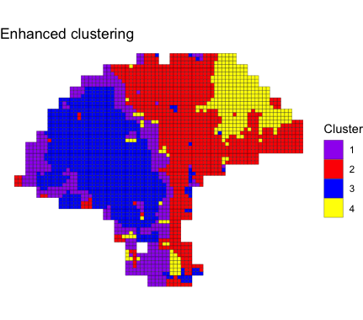
Clustering
Load data
Preprocessing
Feature selection / Dimension reduction
Clustering
Annotation
Enhancing resolution (2/2)
clusterPlot(melanoma.enhanced, palette=palette, color="black", size=0.1) +labs(title="BayesSpace")

Slide 38
Annotation
Load data
Preprocessing
Feature selection / Dimension reduction
Clustering
Annotation
Rough cell type check (1/2)
markers = list()
markers[["Tumor"]] = c("PMEL")
markers[["Fibroblast"]] = c("COL1A1")
markers[["Macrophage"]] = c("CD14", "FCGR1A", "FCGR1B")
markers[["B-cell"]] = c("CD19", "MS4A1")
markers[["T-cell"]] = c("CD2", "CD3D", "CD3E", "CD3G", "CD7")
sum_counts = function(sce, features) {
if (length(features) > 1) {
colSums(logcounts(sce)[features, ])
} else {
logcounts(sce)[features, ]
}
}
spot_expr = purrr::map(markers, function(xs) sum_counts(melanoma, xs))
enhanced_expr = purrr::map(markers, function(xs) sum_counts(melanoma.enhanced, xs))
plot_expression = function(sce, expr, title){
featurePlot(sce, expr, color=NA) + viridis::scale_fill_viridis(option="A")+
labs(title=title, fill="Log-normalized\nexpression")
}
plot_expression_comparison = function(cell_type){
spot.plot = plot_expression(melanoma, spot_expr[[cell_type]],"Spot")
enhanced.plot = plot_expression(melanoma.enhanced, enhanced_expr[[cell_type]],"Enhanced")
spot.plot + enhanced.plot) +
plot_annotation(title=cell_type,
theme=theme(plot.title=element_text(size=18)))
}

Slide 39
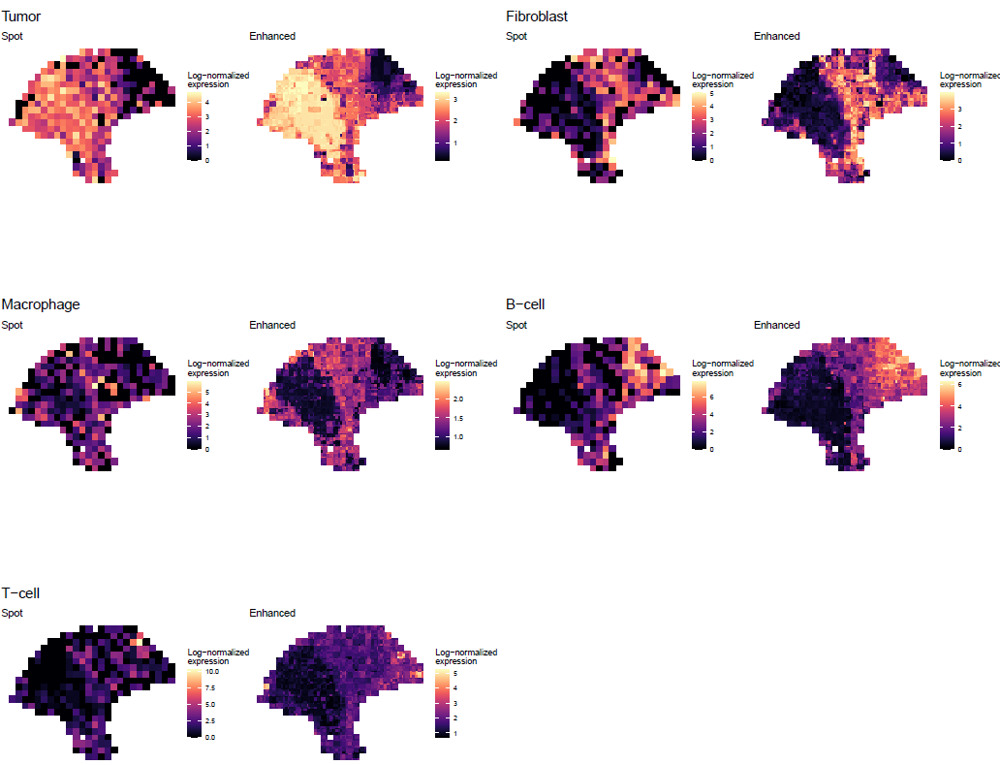
Annotation
Load data
Preprocessing
Feature selection / Dimension reduction
Clustering
Annotation
Rough cell type check (2/2)
hvgs = top[grep("^RP[LS]", top, invert=TRUE)]
melanoma.enhanced = enhanceFeatures(melanoma.enhanced, melanoma,
model="xgboost",
feature_names=hvgs, nrounds=0)
p1 = plot_expression_comparison("Tumor")
p2 = plot_expression_comparison("Fibroblast")
p3 = plot_expression_comparison("Macrophage")
p4 = plot_expression_comparison("B-cell")
p5 = plot_expression_comparison("T-cell")
pdf('rough.pdf', width = 10.5*1.7, height = 9*1.7)
cowplot::plot_grid(p1,p2,p3,p4,p5, ncol=2)
dev.off()
For each spot, linear model lm(gene ~ PCs) is fitted and supspots’ gene expression is predicted with subspots’ PC

Slide 40
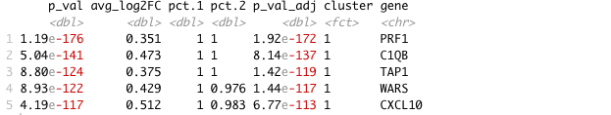
Annotation
Load data
Preprocessing
Feature selection / Dimension reduction
Clustering
Annotation
Find Marker genes for each cluster
sobj = Seurat::CreateSeuratObject(counts=logcounts(melanoma.enhanced),
assay='Spatial’,
meta.data=as.data.frame(colData(melanoma.enhanced)))
sobj = Seurat::SetIdent(sobj, value = "spatial.cluster")
sobj@assays$Spatial@scale.data =
sobj@assays$Spatial@data %>% as.matrix %>% t %>% scale %>% t
top_markers = Seurat::FindAllMarkers(sobj, assay='Spatial', slot='data’,
group.by='spatial.cluster', only.pos=TRUE) %>% group_by(cluster)
%>% top_n(5, avg_log2FC)
head(top_markers,2)

Slide 41
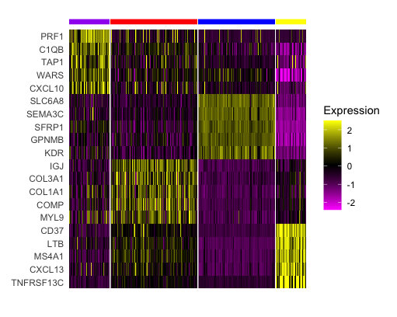
Annotation
Load data
Preprocessing
Feature selection / Dimension reduction
Clustering
Annotation
Visualize marker genes expression with heatmap
Seurat::DoHeatmap(sobj,
features = top_markers$gene, slot='scale.data’,
group.by = "spatial.cluster", group.colors=palette,
angle=0, size=4, label = FALSE, raster=FALSE) + guides(col = FALSE)

Slide 42
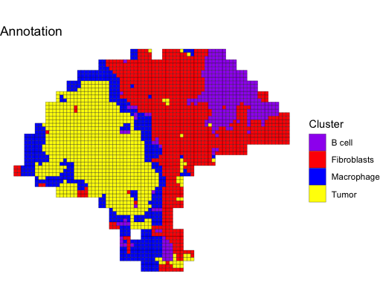
Annotation
Load data
Preprocessing
Feature selection / Dimension reduction
Clustering
Annotation
Annotate spots for enhaced object
coldata = colData(melanoma.enhanced)
coldata$spatial.cluster.annotation = ifelse(coldata$spatial.cluster == 1, 'Macrophage',ifelse(coldata$spatial.cluster == 2,'Fibroblasts',ifelse(coldata$spatial.cluster == 3, 'Tumor','B cell’)))
colData(melanoma.enhanced)= coldata
clusterPlot(melanoma.enhanced, palette=palette,
color="black", size=0.1,
label = "spatial.cluster.annotation") +
labs(title="Annotation")
saveRDS(melanoma.enhanced,
'melanoma_enhanced.rds')

Slide 43
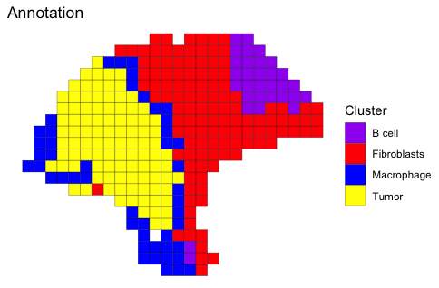
Annotation
Load data
Preprocessing
Feature selection / Dimension reduction
Clustering
Annotation
Annotate spots for melanoma object
coldata = colData(melanoma)
coldata$spatial.cluster.annotation = ifelse(coldata$spatial.cluster == 1, 'Macrophage',ifelse(coldata$spatial.cluster == 2,'Fibroblasts',ifelse(coldata$spatial.cluster == 3, 'Tumor','B cell’)))
colData(melanoma)= coldata
clusterPlot(melanoma, palette=palette,
color="black", size=0.1,
label = "spatial.cluster.annotation") +
labs(title="Annotation")
saveRDS(melanoma, 'melanoma.rds')

Slide 44
Cell-cell interaction - CellChat
4

Slide 45
Dataset Description
For convenience, we will be using a recently released dataset of sagital mouse brain slices generated using the Visium v1 chemistry. There are two serial anterior sections, and two (matched) serial posterior sections.
Biological annotations of spots (i.e., cell group information) are predicted using Seurat (https://satijalab.org/seurat/articles/spatial_vignette.html).
https://www.10xgenomics.com/resources/datasets/mouse-brain-serial-section-1-sagittal-anterior-1-standard-1-0-0

Slide 46
Download packages in current R environment
BiocManager::install("BiocNeighbors")
devtools::install_github("sqjin/CellChat")

Slide 47
Load packages in current R environment
invisible(lapply(c(‘CellChat’, ‘patchwork’), function(x) library(x, character.only=TRUE)))
options(stringsAsFactors = FALSE)
set.seed(1234)

Slide 48
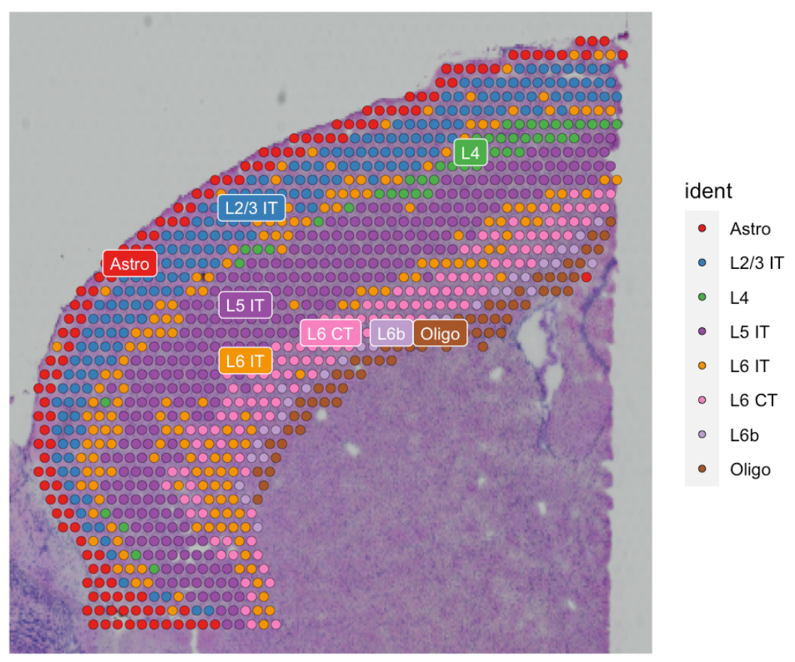
Load dataset
Load data
Preprocessing
Infer cell-cell communication network
Find ligand-receptor pairs
Visualization
Load data
visium.brain = readRDS(url("https://parkjooyoung99.github.io/KOGO_2023/data/KOGO_2023_spatial_transcriptomics_cortex_object.rds"))
visium.brain$manual_annotation = factor(visium.brain$manual_annotation, levels=c('Astro', 'L2/3 IT', 'L4', 'L5 IT','L6 IT', 'L6 CT', 'L6b', 'Oligo’))
Idents(visium.brain) = visium.brain$manual_annotation
colors = scPalette(nlevels(visium.brain))
names(colors) = c('Astro', 'L2/3 IT', 'L4', 'L5 IT','L6 IT', 'L6 CT', 'L6b', 'Oligo’)
SpatialDimPlot(visium.brain, label = T, label.size = 3, cols = colors)

Slide 49
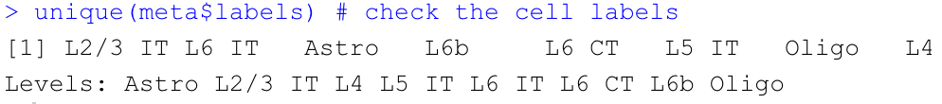
Load dataset
Load data
Preprocessing
Infer cell-cell communication network
Find ligand-receptor pairs
Visualization
Prepare input data for CellChat analysis
data.input = GetAssayData(visium.brain, slot = "data", assay = "SCT")
meta = data.frame(labels = Idents(visium.brain), row.names = names(Idents(visium.brain)))
unique(meta$labels) # check the cell labels

Slide 50
Load dataset
Load data
Preprocessing
Infer cell-cell communication network
Find ligand-receptor pairs
Visualization
Load spatial imaging information
spatial.locs = GetTissueCoordinates(visium.brain, scale = NULL, cols = c("imagerow", "imagecol"))
scale.factors = jsonlite::fromJSON(txt = url('https://parkjooyoung99.github.io/KOGO_2023/data/scalefactors_json.json'))
scale.factors = list(spot.diameter=65, spot=scale.factors$spot_diameter_fullres,
fiducial = scale.factors$fiducial_diameter_fullres,
hires = scale.factors$tissue_hires_scalef,
lowres = scale.factors$tissue_lowres_scalef
)

Slide 51
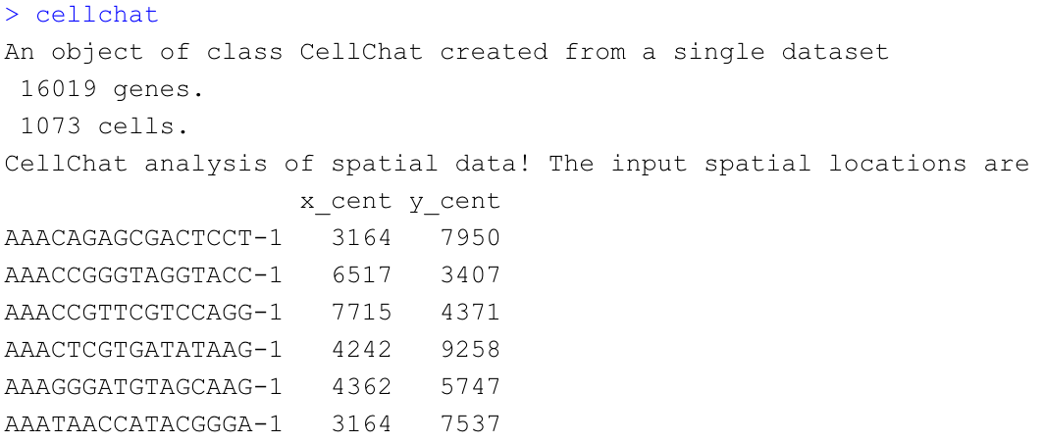
Create a CellChat object
Load data
Preprocessing
Infer cell-cell communication network
Find ligand-receptor pairs
Visualization
Create a CellChat object
cellchat = createCellChat(object = data.input, meta = meta, group.by = "labels",
datatype = "spatial", coordinates = spatial.locs, scale.factors = scale.factors)
cellchat

Slide 52
Set the ligand-receptor interaction database
Load data
Preprocessing
Infer cell-cell communication network
Find ligand-receptor pairs
Visualization
CellChatDB = CellChatDB.mouse
cellchat@DB = CellChatDB

Slide 53
Preprocessing the expression data for cell-cell communication analysis
Load data
Preprocessing
Infer cell-cell communication network
Find ligand-receptor pairs
Visualization
cellchat = subsetData(cellchat)
future::plan("multiprocess", workers = 4) # do parallel
cellchat = identifyOverExpressedGenes(cellchat)
cellchat = identifyOverExpressedInteractions(cellchat)
subsetdata() : subset the expression data of signaling genes for saving computation cost
Identify over-expressed ligands or receptors in one cell group
Identify over-expressed ligand-receptor interactions if either ligand or receptor is over-expressed.

Slide 54
Inference of cell-cell communication network
Load data
Preprocessing
Infer cell-cell communication network
Find ligand-receptor pairs
Visualization
Compute the communication probability and infer cellular communication network
cellchat = computeCommunProb(cellchat, type = "truncatedMean", trim = 0.1,
distance.use = TRUE, interaction.length = 200,
scale.distance = 0.01)
cellchat = filterCommunication(cellchat, min.cells = 10)
Infers the biologically significant cell-cell communication by assigning each interaction with a probability value and performing a permutation test.
Models the probability of cell-cell communication by integrating gene expression with spatial locations as well as prior known knowledge of the interactions between signaling ligands, receptors and their cofactors using the law of mass action.

Slide 55
Inference of cell-cell communication network
Load data
Preprocessing
Infer cell-cell communication network
Find ligand-receptor pairs
Visualization
Infer the cell-cell communication at a signaling pathway level
cellchat = computeCommunProbPathway(cellchat)
Computes the communication probability on signaling pathway level by summarizing the communication probabilities of all ligands-receptors interactions associated with each signaling pathway
The inferred intercellular communication network of each ligand-receptor pair and each signaling pathway is stored in the slot ‘net’ and ‘netP’, respectively.

Slide 56
Inference of cell-cell communication network
Load data
Preprocessing
Infer cell-cell communication network
Find ligand-receptor pairs
Visualization
Calculate the aggregated cell-cell communication network
cellchat = aggregateNet(cellchat)
Calculate the aggregated cell-cell communication network by counting the number of links or summarizing the communication probability. USER can also calculate the aggregated network among a subset of cell groups by setting sources.use and targets.use.

Slide 57
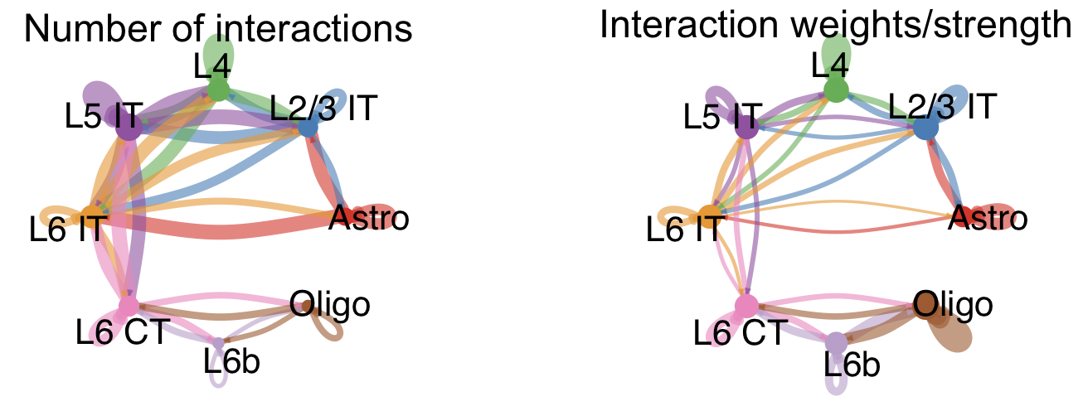
Inference of cell-cell communication network
Load data
Preprocessing
Infer cell-cell communication network
Find ligand-receptor pairs
Visualization
Visualization of the aggregated cell-cell communication network
groupSize = as.numeric(table(cellchat@idents))
par(mfrow = c(1,2), xpd=TRUE)
netVisual_circle(cellchat@net$count, vertex.weight = rowSums(cellchat@net$count), weight.scale = T, label.edge= F, title.name = "Number of interactions")
netVisual_circle(cellchat@net$weight, vertex.weight = rowSums(cellchat@net$weight), weight.scale = T, label.edge= F, title.name = "Interaction weights/strength")

Slide 58
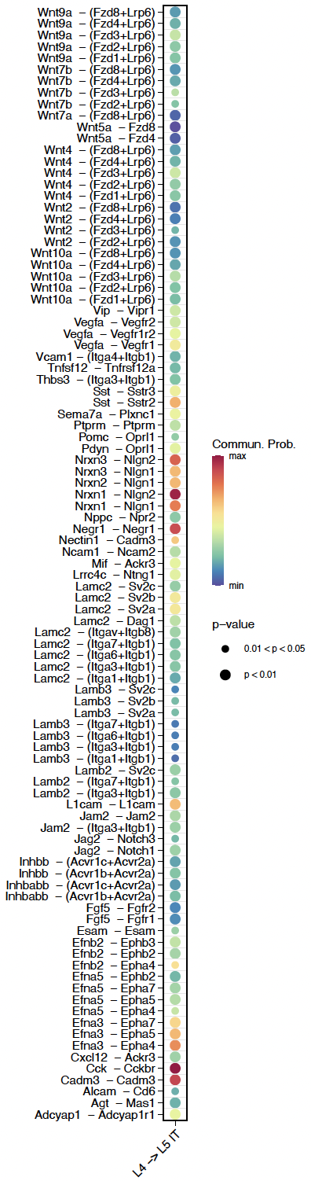
Identify ligand-receptor pairs associated with CXCL pathway
Load data
Preprocessing
Infer cell-cell communication network
Find ligand-receptor pairs
Visualization
CellChat::netVisual_bubble(cellchat, sources.use = c(3), targets.use =c(4), remove.isolate = FALSE, angle.x = 45,thresh = 0.05)
Receptor and ligand pair associated with CXCL signaling

Slide 59
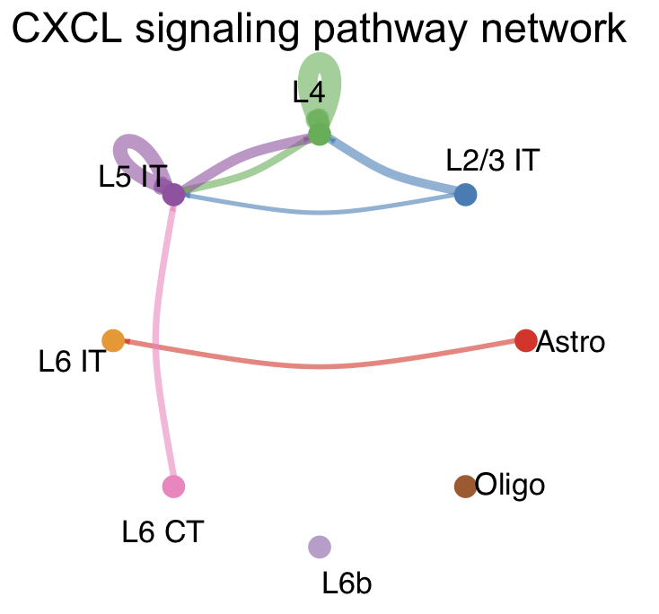
Visualization of cell-cell communication network
Load data
Preprocessing
Infer cell-cell communication network
Find ligand-receptor pairs
Visualization
Circle Plot
pathways.show = c("CXCL")
par(mfrow=c(1,1))
netVisual_aggregate(cellchat, signaling = pathways.show, layout = "circle")

Slide 60
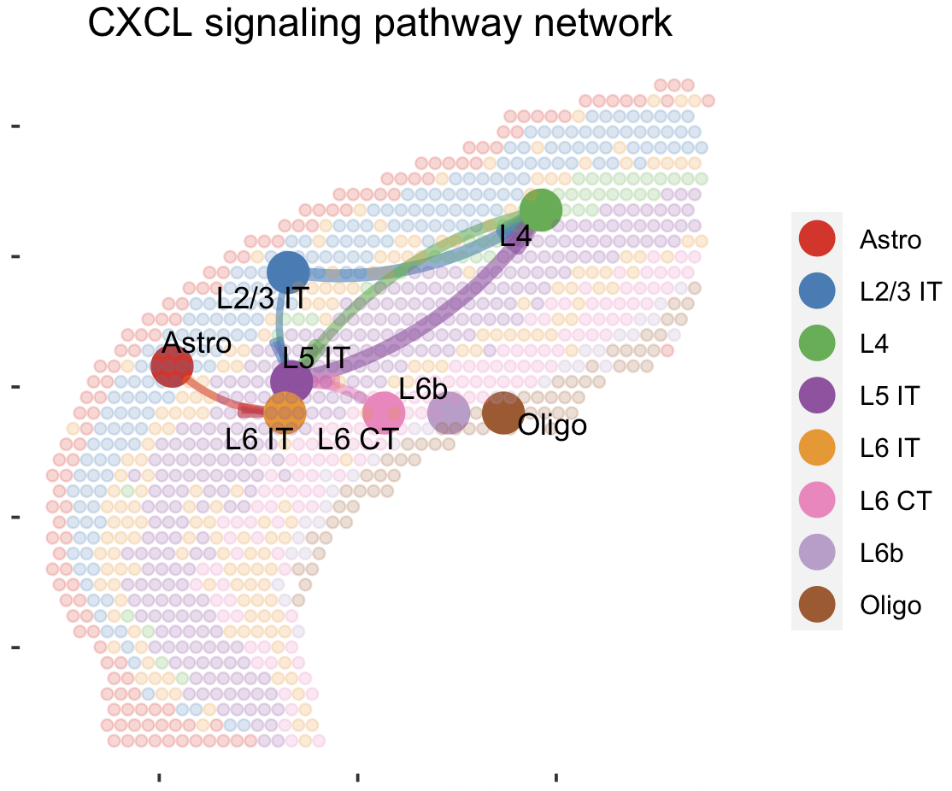
Visualization of cell-cell communication network
Load data
Preprocessing
Infer cell-cell communication network
Find ligand-receptor pairs
Visualization
Spatial Plot
par(mfrow=c(1,1))
netVisual_aggregate(cellchat, signaling = pathways.show, layout = "spatial", edge.width.max = 2, vertex.size.max = 1, alpha.image = 0.2, vertex.label.cex = 3.5)
Visualization information on the spatial imaging

Slide 61
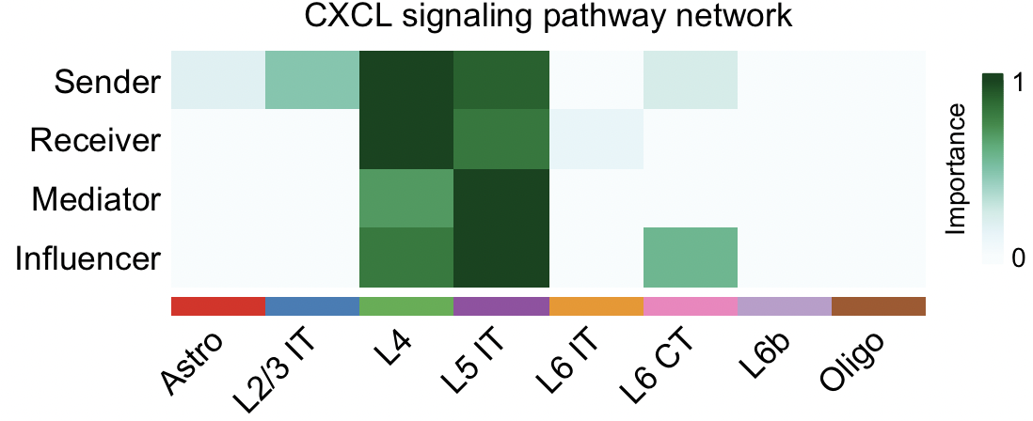
Visualization of cell-cell communication network
Load data
Preprocessing
Infer cell-cell communication network
Find ligand-receptor pairs
Visualization
Compute the network centrality scores
cellchat = netAnalysis_computeCentrality(cellchat, slot.name = "netP")
par(mfrow=c(1,1))
netAnalysis_signalingRole_network(cellchat, signaling = pathways.show, width = 8, height = 2.5, font.size = 10)
'netP’: the inferred intercellular communication network of signaling pathways
Visualize the computed centrality scores using heatmap, allowing ready identification of major signaling roles of cell groups

Slide 62
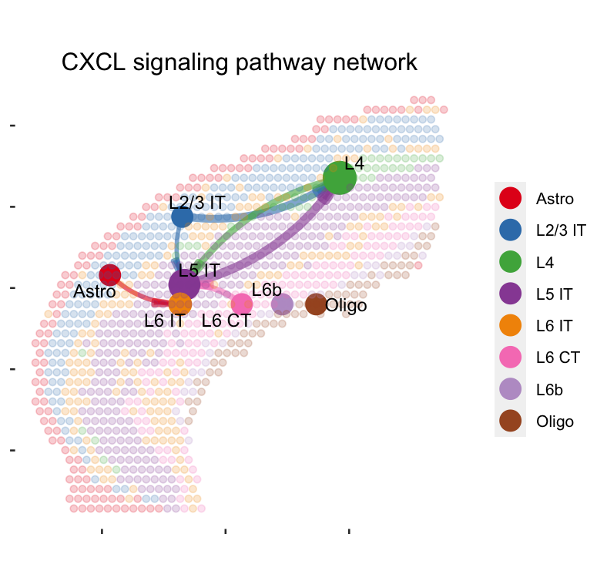
Visualization of cell-cell communication network
Load data
Preprocessing
Infer cell-cell communication network
Find ligand-receptor pairs
Visualization
Spatial Plot
par(mfrow=c(1,1))
netVisual_aggregate(cellchat, signaling = pathways.show, layout = "spatial", edge.width.max = 2, alpha.image = 0.2, vertex.weight = "incoming", vertex.size.max = 3, vertex.label.cex = 3.5)
Visualization information on the spatial imaging
Bigger circle indicates larger incoming signaling

Slide 63
Summary
Use SpaceRanger to generate a gene-spot matrix file from 10X Genomics Visium sequence data (FASTQ files)
Install Space Ranger
Run spaceranger count command
Load a Visium dataset as a SinglecellExperiment
Clustering Analysis - BayesSpace
Load data and explore SinglecellExperiment object
Pre-processing (Log-normalization)
Feature selection / Dimension reduction with PCA
Clustering with enhancing resolution methods and annotate each spatial cluster with marker genes
Cell-cell interaction - CellChat
Load data and create CellChat object
Pre-processing the expression data for the cell-cell communication analysis
Compute the communication probability and infer the cellular communication network
Visualization of the cell-cell communication network with circle plot and spatial plot

Slide 64
Q & A

